Slide 1

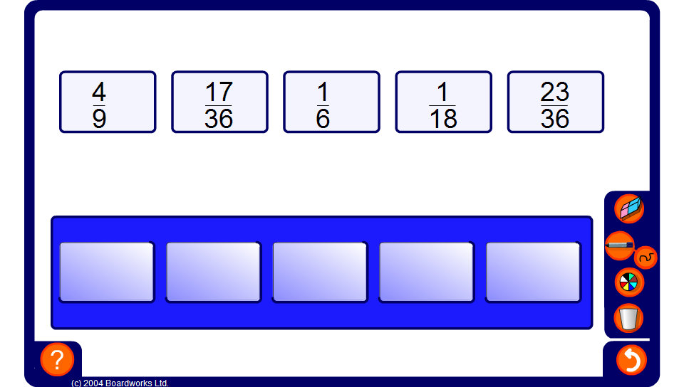


Ordering fractions
Notes:
Ask pupils to order the fractions on the board using an appropriate method.

